Slide 1

CSD 3102 ARTIFICIAL INTELLIGENCE TECHNIQUES MODULE IV
PLANNING
Topic: Means Ends Analysis

Slide 2
MODULE IV | PLANNING |  |  |  | 9
Planning Problem – Simple Planning agent –Blocks world - Goal Stack Planning- Means Ends Analysis- Planning as a Statespace Search - Partial Order Planning-Planning Graphs-Hierarchical Planning - Non- linear Planning -Conditional Planning-Reactive Planning - Knowledge based Planning-Using Temporal Logic – Execution Monitoring and Re-planning- Continuous Planning-Multi-agent Planning-Job shop Scheduling Problem.

Slide 3
Means Ends Analysis
The planning strategies can reason either in forward or backward, but a mixture of the two directions is appropriate for solving a complex and large problem.
Such a mixed strategy, make it possible that first to solve the major part of a problem and then go back and solve the small problems arise during combining the big parts of the problem.
Such a technique is called Means-Ends Analysis. Means-Ends Analysis is problem-solving techniques used in Artificial intelligence for limiting search in AI programs.
It is a mixture of Backward and forward search technique. The MEA technique was first introduced in 1961 by Allen Newell, and Herbert A. Simon in their problem solving computer program, which was named as General Problem Solver (GPS).
The MEA analysis process centered on the evaluation of the difference between the current state and goal state.

Slide 4
How means-ends analysis Works ?
The means-ends analysis process can be applied recursively for a problem. It is a strategy to control search in problem-solving.
Following are the main steps which describes the working of MEA technique for solving a problem.
First, evaluate the difference between Initial State and final State.
Select the various operators which can be applied for each difference.
Apply the operator at each difference, which reduces the difference between the current state and goal state.

Slide 5
Operator Subgoaling
In the MEA process, we detect the differences between the current state and goal state.
Once these differences occur, then we can apply an operator to reduce the differences. But sometimes it is possible that an operator cannot be applied to the current state.
So we create the sub problem of the current state, in which operator can be applied, such type of backward chaining in which operators are selected, and then sub goals are set up to establish the preconditions of the operator is called Operator Subgoaling.

Slide 6
Algorithm for Means-Ends Analysis:
Let's take Current state as CURRENT and Goal State as GOAL, then the steps for the MEA algorithm are following.
Step 1: Compare CURRENT and GOAL, and if there are no discrepancies, return Success and Exit.
Step 2: If not, choose the most significant difference and lessen it by following the steps below until success or failure is achieved.
Choose a new operator O that applies to the current difference, and if no such operator exists, signal failure.
Try to apply operator O to CURRENT. Make description of two states.
O-Start, a state in which O?s preconditions are satisfied.
O-Result, the state that would result if O were applied In O-start.
If (First-Part <------ MEA (CURRENT, O-START) And (LAST-Part <----- MEA (O-Result, GOAL), are successful, then signal Success and return the result of combination of FIRST-PART, O, and LAST-PART.

Slide 7
Step-by-Step Explanation of Means-Ends Analysis
Step 1: Compare Current and Goal
Action: Begin by comparing the CURRENT state with the GOAL state.
Outcome: 1. If they are identical (no discrepancies), return Success and exit the process.
2.If there are discrepancies (differences between the two states), proceed to the next step.

Slide 8
Step 2: Identify and Address Significant Differences
Action: Identify the most significant difference between the CURRENT state and the GOAL state.
Process:
1. Choose a new operator (action) O that can help address this difference.
2. If no applicable operator exists, signal failure and exit.
Apply Operator O

Slide 9
Apply Operator O:
Description of Two States: O-Start: This is the state where the preconditions for applying operator O are satisfied.
O-Result: This is the state that would result after applying operator O to O-Start.
Recursive Calls with MEA:
Now, we perform two recursive calls to the MEA function:

Slide 10
1. First Part:Call MEA(CURRENT,O−START ) to find a way to transition from the CURRENT state to the O-Start state. This handles the first part of the difference.
2. Last Part:Call MEA(O−RESULT,GOAL) to find a way to transition from the O-Result state to the GOAL state. This handles the second part of the difference.

Slide 11
Combining Results
Condition:
If both recursive calls are successful, it indicates that the action has successfully
reduced the difference:
The transition from CURRENT to O-Start was successful.
The transition from O-Result to GOAL was also successful.
Action:
Signal Success and return the result, which is a combination of:
FIRST-PART: The result from the first MEA call.
Operator O: The action applied.
LAST-PART: The result from the last MEA call.

Slide 12

Example of Mean-Ends Analysis:
Let's look at an example where we know the starting state and the desired state. In this issue, we must detect differences between the beginning state and the goal state and apply operators to obtain the goal state.

Slide 13

Solution:
To solve the problem, we will first identify the differences between starting and goal states, then construct a new state and apply the operators to each difference. For this problem, we have the following operators:
Move
Delete
Expand
1. Evaluating the initial state: In the first step, we'll evaluate the initial state and compare it to the Goal state to see what the differences Evaluating the initial state: In the first step, we'll evaluate the initial state and compare it to the Goal state to see what the differences are.

Slide 14
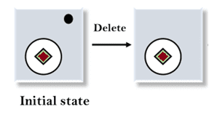
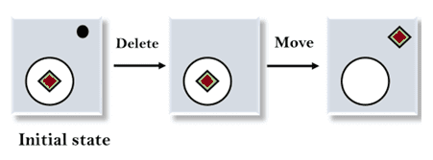
2. Applying the Delete operator: As you can see, the first difference is that there's no dot symbol in the Goal state, whereas there is in the initial state, so we'll use the Delete operator to remove it.
3. Applying the Move Operator: After using the Delete operator, a new state appears, which we will compare to the objective state again. After comparing these states, we notice that the square is outside the circle, so we'll use the Move Operator to fix it.

Slide 15
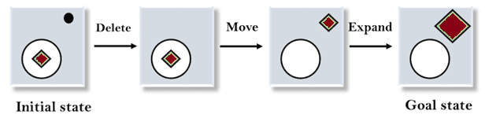
4. Applying the Expand Operator: In the third phase, a new state is created, and we will compare it to the desired state. There is still one difference between the states, which is the size of the square, so we will use the Expand operator to construct the desired state.

Slide 16
Example 2:
Let's illustrate this with a simple example involving getting a glass of water.
CURRENT: You are in the living room without water.
GOAL: You have a glass of water.

Slide 17
Step 1: Compare CURRENT and GOAL
Comparison:
Discrepancy found (you do not have water).
Step 2: Identify and Address Differences
Significant Difference: You need to get water.
Choose Operator O: "Go to the kitchen."
O-Start: You are in the living room (which requires an action to reach the kitchen).
O-Result: You are in the kitchen (where the water is).

Slide 18
Apply MEA Recursively
First Part:
MEA(CURRENT,O−START)- Moving from the living room to the kitchen.
Last Part:
MEA(O−RESULT,GOAL) - Once in the kitchen, fill the glass with water.

Slide 19
Combining Results
If both actions are successful (you reach the kitchen and fill the glass):
Signal Success and return the sequence:
Move to Kitchen
Fill Glass with Water
This structured approach to Means-Ends Analysis effectively addresses complex problems by breaking them down into manageable parts. By comparing the current state with the goal, identifying significant differences, and recursively applying actions to bridge those gaps, MEA provides a clear pathway to reach the desired outcomes in various scenarios.

